Slide 1


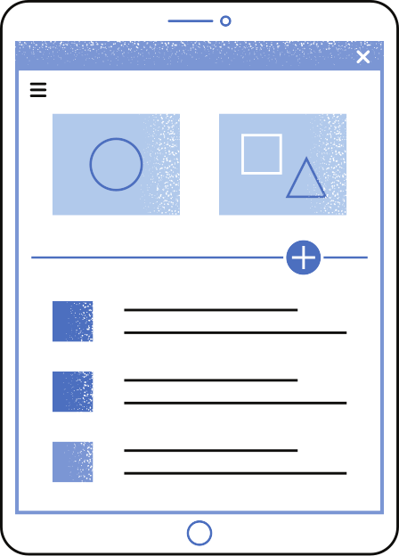
Group B
Introduction
Oct 4, 2024
Organ Leader & Decision Making

Slide 2

TEAM MEMBERS
Nabin Baral
Pawan Dhungana
Niharika Kondi
Lakshmi Praneetha Madala
Mohamad Arif Nedaria

Slide 3

Overview
We will discuss circuit city timeline and propose strategic plan for its revival:
The history of Circuit City. Rise and Downfall.
Issues and challenges leading to 2009, and ultimately bankruptcy.
Comeback story of 2018, how it exists in collaboration with JCPenney and its online store.
Issues and challenges in 2018 and beyond?
Its major competitors and their moat.
How can IT deliver to help Circuit City thrive in business?
How can IT deliver for Circuit City to reach global ecommerce market?
How we can leverage Innovative Technologies such as Social media, Big Data, AI to help Circuit City succeed?
How we can leverage Emerging Technologies such as AR,VR, AI, MI to help Circuit City succeed?

Slide 4
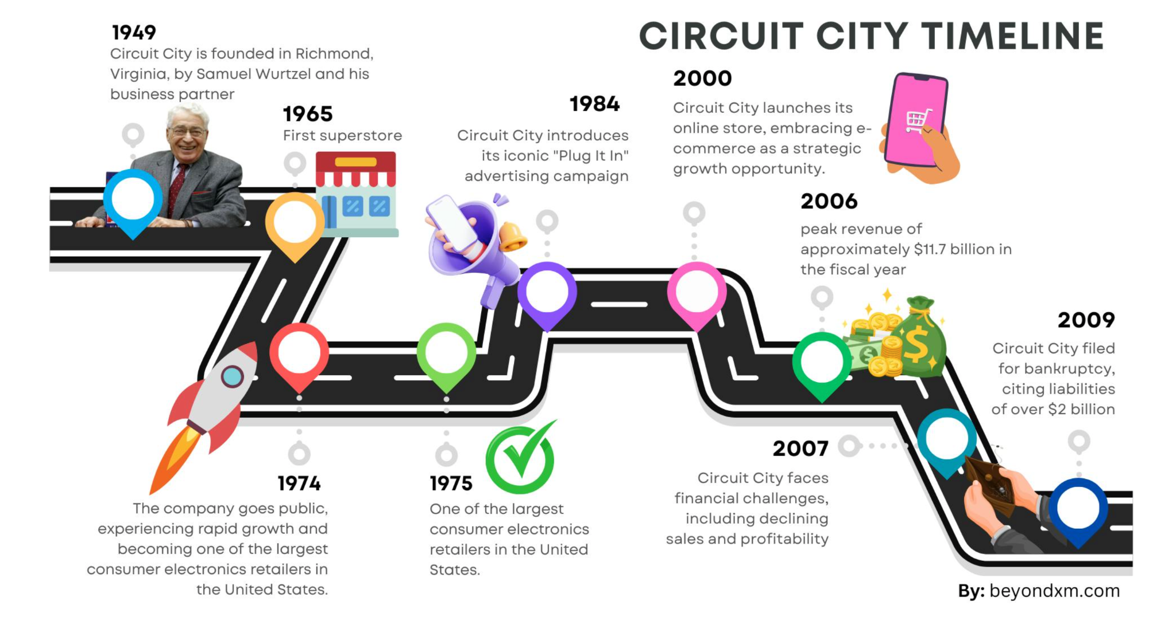

Slide 5
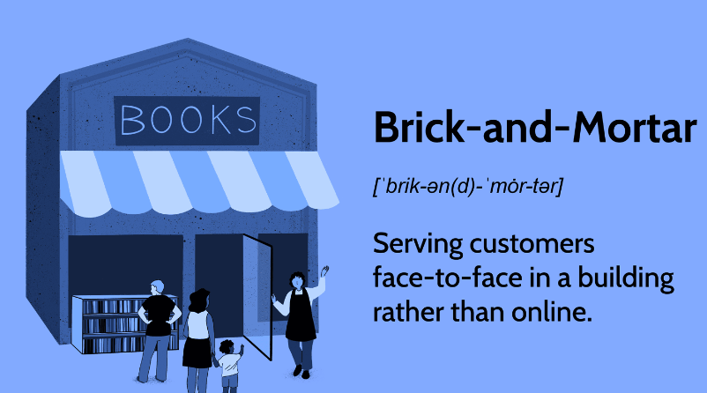
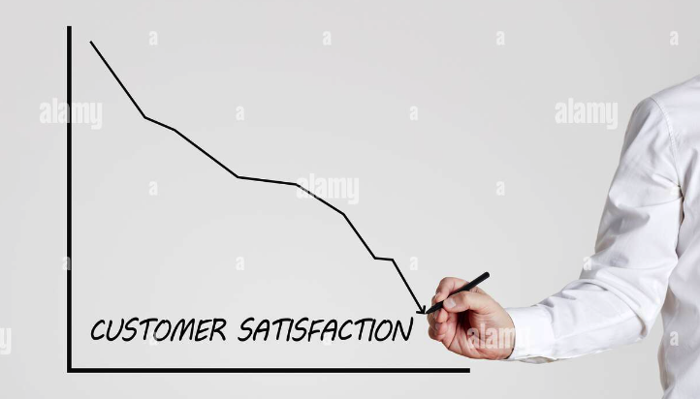
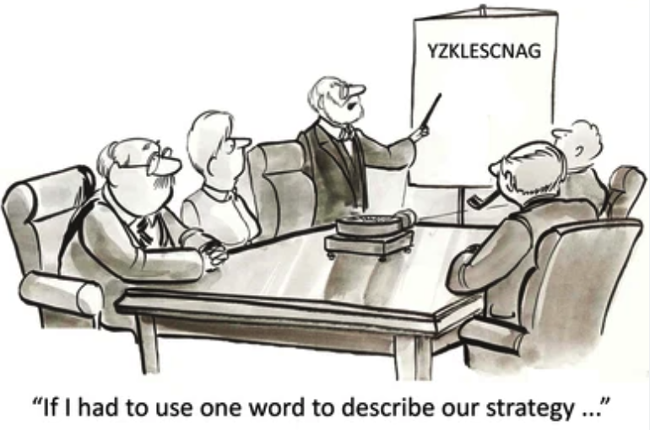
Issues: Collapse of Circuit City(2009)
Stuck to traditional Brick and Mortar
Declining Customer Satisfaction
Poor Strategic Choices
Decided to stay in traditional form of business while competition was moving digital and self service
Online presence very insignificant with Online and instore product price discrepancy
Firing of high paid experienced employees with inexperienced employees resulted in massive customer dissatisfaction(2007)
Loss of Upselling opportunity
They lost competitive advantage for instore
customer satisfaction in around 600 stores
1987, reached first billion in sales
2000, new CEO betting from appliances to electronics
2003, eliminating commission on sales
2007, firing great sales team
2008/2009, going headon with best buy with no plan

Slide 6
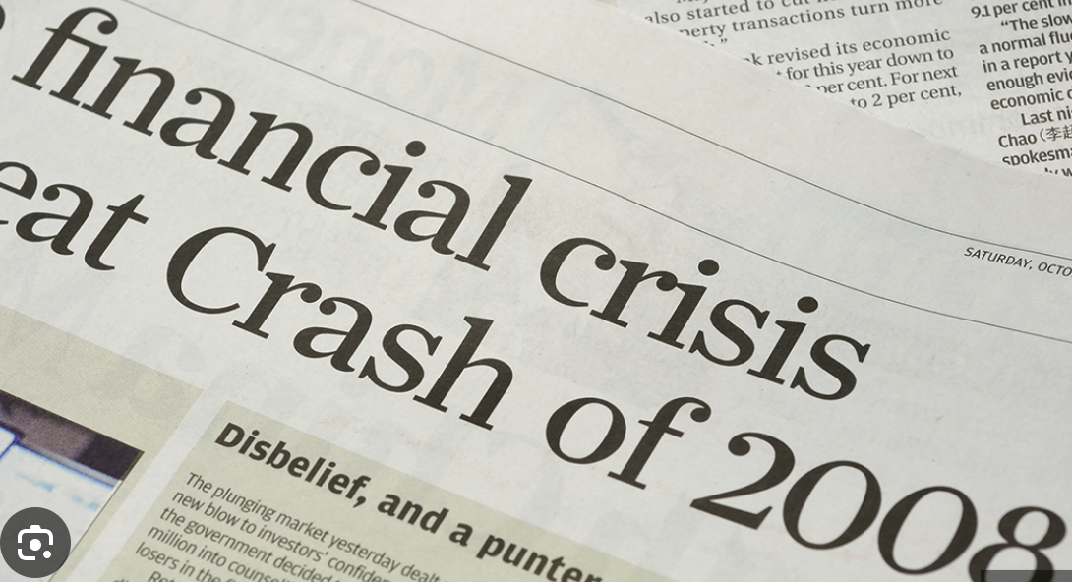
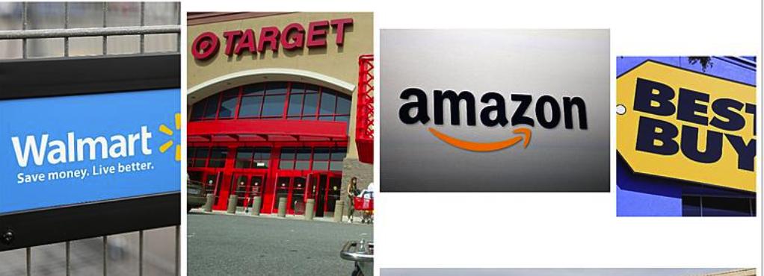
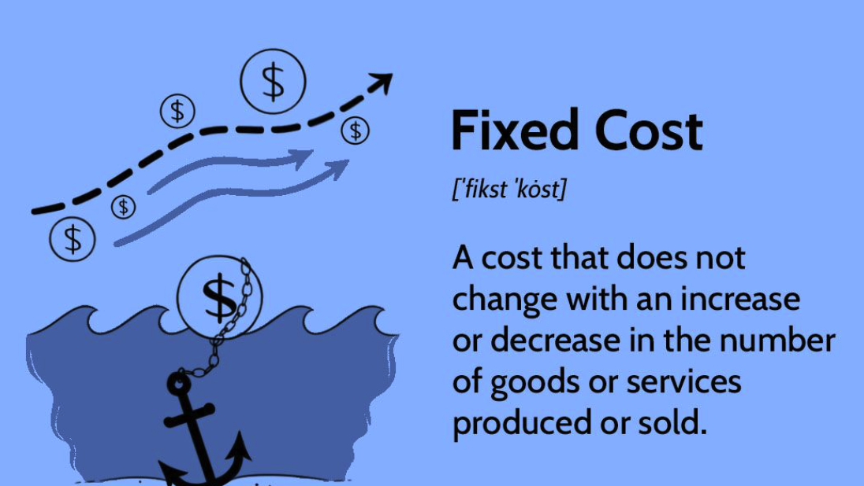
Challenges: Collapse of Circuit City(2009)
Economic Downturn
Intense Competition
High Fixed Cost
2008 financial crisis led to plummeting consumer spending, hammering already fragile financial situation
Other ecommerce companies offered better customer service and prices and being more adaptive to changes
567 stores in USA
770 stores in Canada
~1 million loss per store yearly(Rent, Salaries,Utilities, Insurance,IT/Administrative)
Online store introduced but poor customer experience, price mismatch, late in game

Slide 7

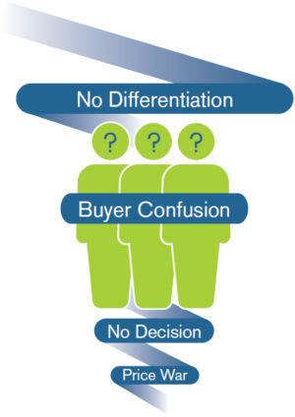

Issues: Circuit City (2018)
Brand Image and Legacy
Lack of Differentiation
Technology and User Experience
Poor reputation due to its bankruptcy in 2009, and the brand associated with failure made it hard to regain customers' trust.
Could not offer anything special compared to well-established competitors in terms of features or value.
Technical problems with the website and not user-friendly. Compared to other websites, Circuit City's platform felt outdated and hard to use.

Slide 8
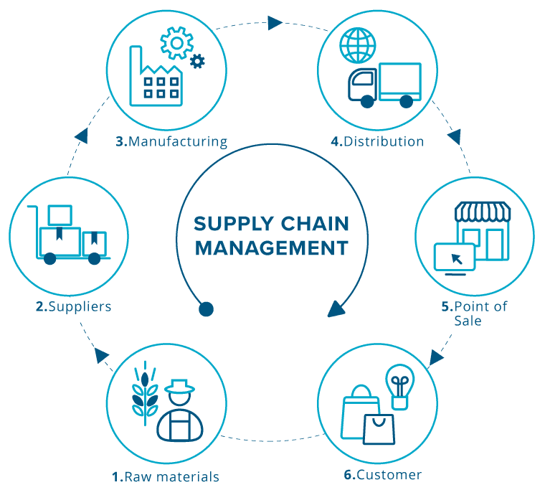

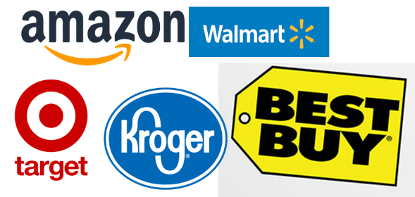
Challenges: Circuit City (2018)
Crowded Marketplace
Rebuilding Brand Loyalty
Supply Chain and Fulfillment
Market already dominated by big players like Amazon and BestBuy. Competing with these giants without any special edge was very difficult.
The company's previous customers had moved on to other brands, and Circuit City lacked the marketing strength and appeal necessary to regain their loyalty.
Circuit City struggled to set up robust supply chain compared to competitors limiting its ability to meet customer expectations for fast order replacement and delivery.

Slide 9



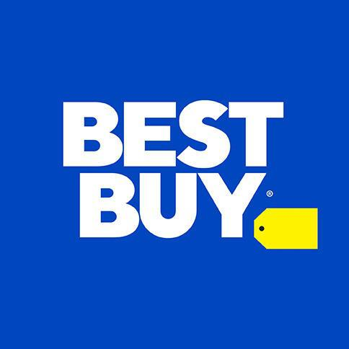

Major Competitors
Prime Membership
AWS
Global Supply Chain
Grocery Business
$1.5 Trillion, 40% MS
$500 Billion, 8% MS
$100 Billion, 2% MS
Store Design and Layout
Collaborations with Designer
Price Matching
In-Store Expertise
Product Depth in Electronics
Community-Driven Content
$.27 Billion, <1% MS
$30 Billion, 2% MS

Slide 10

How can IT deliver for Circuit City?
Through
Operational Efficiency
Innovation and Competitive Advantage
Data-Driven Decisions
Better Customer Experience
Security & Risk Management

Slide 11
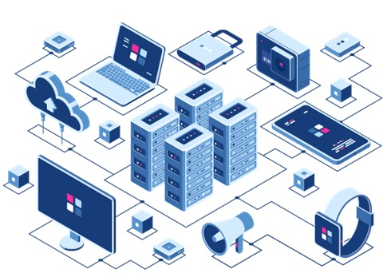
How can IT Infrastructure Deliver Global E-Commerce?
Through
Cloud-based servers: Offering stability, and cost-effectiveness to manage worldwide traffic.
Content Delivery Network
High-Performance Databases
Cybersecurity measures: including firewalls, encryption, and intrusion detection systems to protect data and transactions.
Payment Gateway Integration

Slide 12
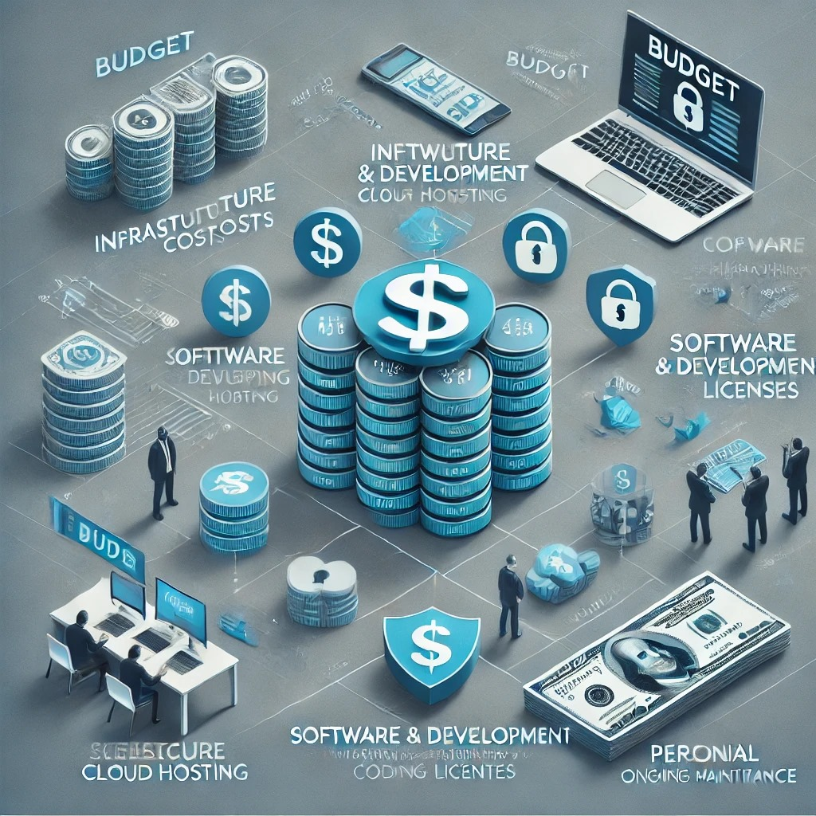
IT - Budget
Cloud Service to protect from Data Leakage and Data Breach.
User friendly Mobile Application help with ease of access.
Marketing and Advertising for holiday season.
With evolving market, spending on Research and Development
Spending on IT staff expansions
Training and Development of Employees

Slide 13
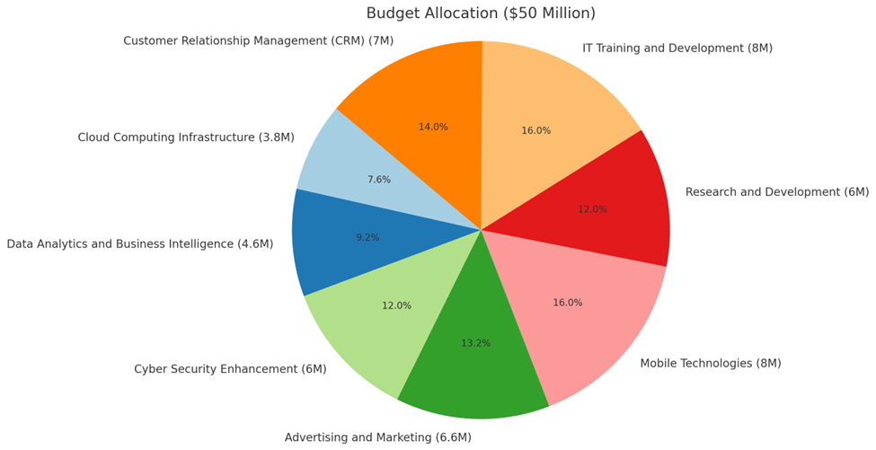
IT -Budget Breakdown
Total Budget: $50 Million
Cloud Computing Infrastructure: $3.8 Million.
Data Analytics and BI: $4.6 Million.
Cyber Security Enhancement: $6 Million.
Advertising and Marketing: $6.6 Million.
Mobile Technologies: $8 Million.
Research and Development: $6 Million.
IT Training and Development: $8 Million.
Customer Relation Systems(CRM): $7 Million.

Slide 14
IT - Risks and Challenges
RISKS | CHALLENGES
Cybersecurity and Data Breaches | Checking robust defenses against data breaches, malware, and ransomware.
System Downtime | Ensuring 24/7 availability and disaster recovery to prevent operational disruptions.
Vendor Risks | Monitoring third-party vendors to prevent breaches in outsourced services.
Cost Management | Managing IT budgets efficiently while investing in cutting-edge technologies.
Data Management | Keeping an eye on accuracy, security, and effective integration of data across various systems.

Slide 15
Leveraging Innovative Technologies
Social Media
Customer Engagement and Feedback
Targeted Marketing
Product Promotion
Community Building
Big Data
Customer Behavior Analysis
Supply Chain Optimization
Pricing Strategies
Predictive Maintenance

Slide 16
Leveraging Innovative Technologies
Business Intelligence
Real-time Dashboards
Sale Performance Analysis
Customer Segmentation
Store Performance
Integration of technologies
Big Data + Social Media
Big Data + BI
Social Media + BI

Slide 17
Emerging Technologies for Competitive Advantage
Artificial Intelligence and Machine Learning
Personalised Shopping Experiences
Chatbots and Virtual Assistants
Predictive Analytics
Augmented Reality and
Virtual Reality
Virtual Shopping Experiences
AR for Product visualization
Enhanced In-Store Experience

Slide 18
Emerging Technologies for Competitive Advantage
Internet of Things (IOT)
Smart Inventory Management
Connected Products
Smart Stores
Blockchain Technology
Supply Chain Transparency
Warranty and Returns
Loyalty Programs
5G Technology
Enhanced Online Shopping
Smart Devices Integration
Real-Time Data Collection

Slide 19

THANK YOU
Questions?

Slide 20
References
Jílková, P., & Králová, P. (2021). Digital consumer behaviour and ecommerce trends during the COVID-19 crisis. International Advances in Economic Research, 27(1), 83-85.
Turban, E., Outland, J., King, D., Lee, J. K., Liang, T. P., & Turban, D. C. (2018). Electronic commerce 2018: a managerial and social networks perspective (Vol. 2017).
Romero, J. E. S. S. I. E. (2013). The rise and fall of Circuit City. Econ Focus, 17(3), 31-33.
Campbell, T. A. (2014). What could have been done? Circuit City: A case study of management and employee performance failure. Performance Improvement, 53(4), 16-23.

